Slide 1
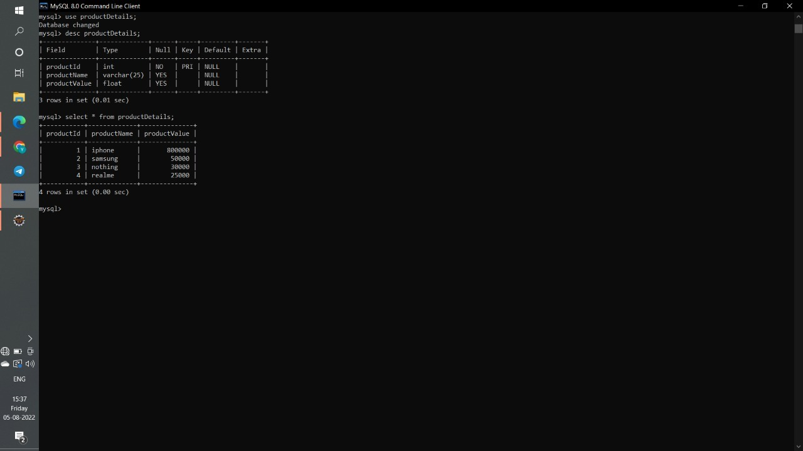
Retrieving the product details using the product id output screenshots.

Slide 2
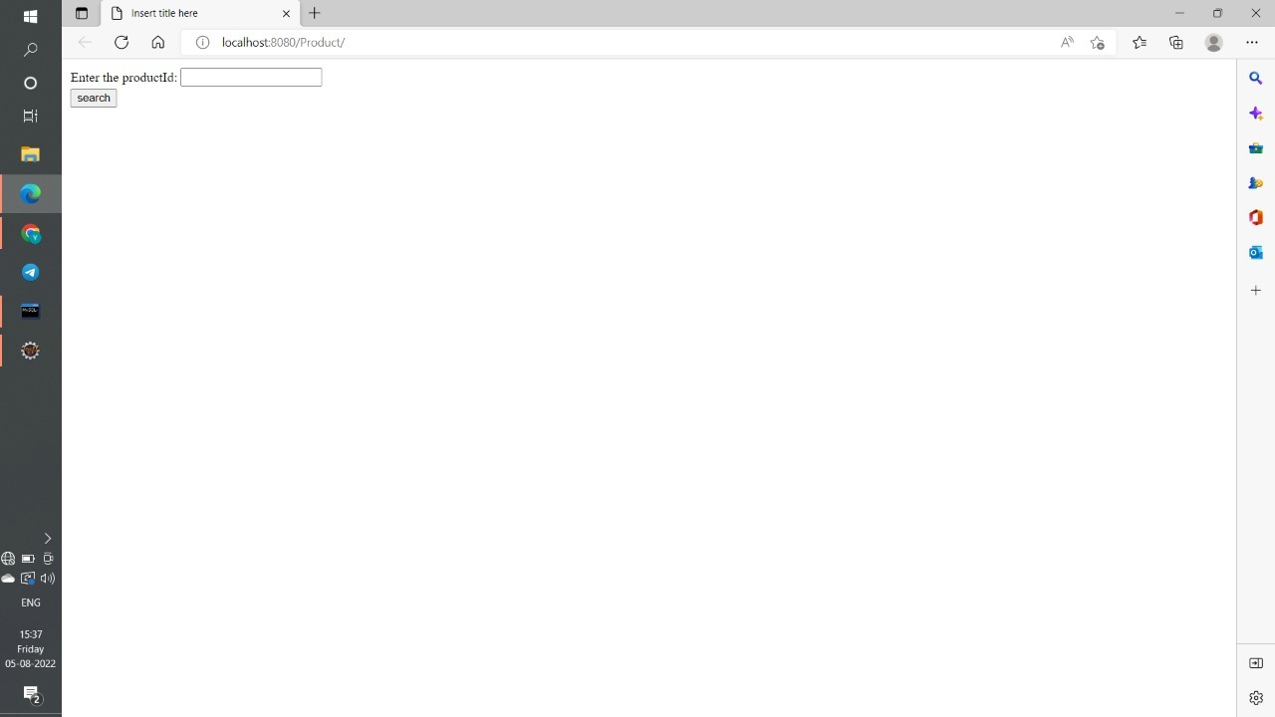

Slide 3
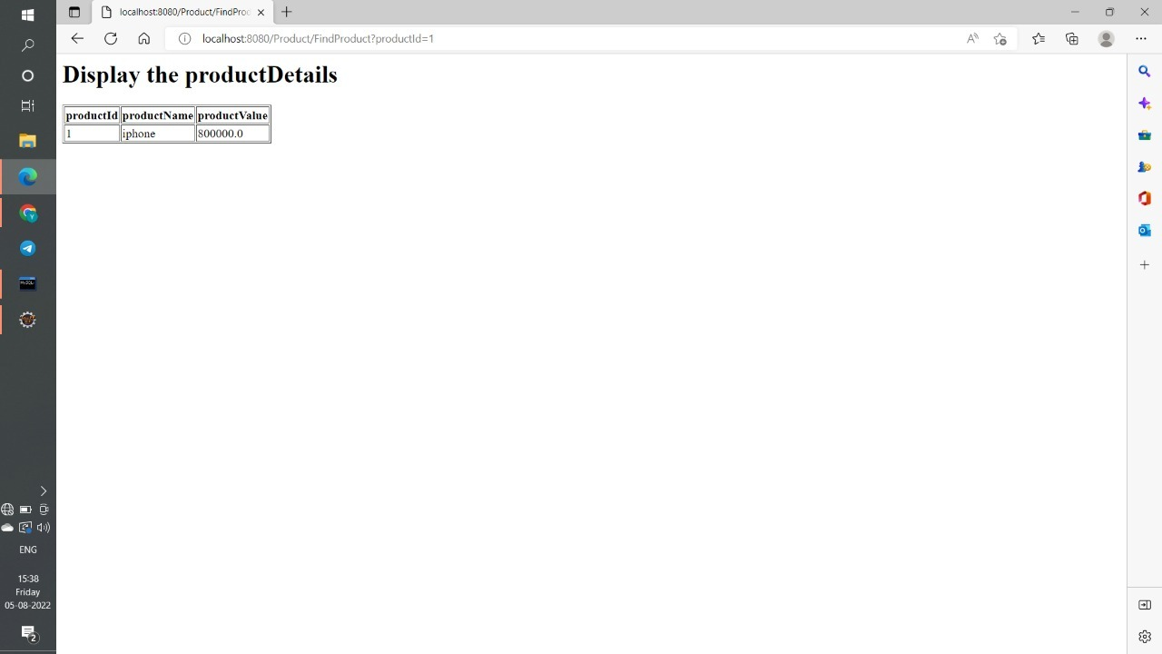

Slide 4


Slide 5


Slide 6


